Slide 1
WEM Governing Body Market Expert briefing on comprehensive scarcity pricing
Susan L. Pope
WEM Governing Body Market Expert
WEM Governing Body Meeting
General Session
July 14, 2026

Slide 2
This presentation provides information to support discussions of scarcity pricing in the Price Formation Enhancements initiative.
Topics
  Role of scarcity pricing in electricity market design
  Brief overview of current CAISO proposal
  Discussion of feedback regarding Comprehensive Scarcity Pricing (CSP)
  Suggestions for next steps
Q&A
Appendix: Comprehensive Scarcity Pricing in U.S. ISOs

Slide 3
What does “scarcity” mean in the context of electricity markets?
As demand increases relative to supply, electricity prices generally increase as more expensive electricity supply is dispatched to serve load and provide reserves
  Grid operational schedules include a variety of reserves to maintain stable and reliable electricity service
Scarcity occurs when physical supply offered into the market is less than the demand for energy plus reserve targets
  Emergency actions can occur, such as voltage reduction, export cuts, activation of demand response, and ultimately load shedding
  In some regions, operating reserves scheduled to balance load and generation following contingencies (e.g., MWs of 10-minute spinning or non-spinning reserves) may be used for energy to avoid shedding load; the dispatch of these reserves to meet load reduces reliability

Slide 4
During scarcity conditions, energy and reserve prices in centrally dispatched markets today would generally not be consistent with the operational state of the grid absent scarcity pricing.
Emergency, “out of market” actions to address scarcity may cause prices to fall
  Emergency actions increase supply or decrease load
Electricity prices should exceed the offer price of the most expensive supply (or demand) resource scheduled under scarcity conditions
  Each megawatt of additional supply increases reliability by decreasing the amount of load shedding or decreasing the probability of shedding load (due to restoring reserve levels)
  In this situation, electricity prices should include the reliability value of an additional megawatt of reserves in addition to the marginal cost of energy

Slide 5
Well-functioning designs increase prices during scarcity conditions, providing efficient incentives for market participant responses that align with sustaining grid reliability.
Decreased consumption by loads that place a lower value on energy than the price (inclusive of a scarcity value)
Increased imports with a lower cost than the scarcity-inclusive price
Efficient charging and discharging of energy limited resources over the day
Efficient efforts by suppliers with day-ahead schedules to meet the schedules in real-time
Efficient O&M expenditures by suppliers (including RA resources) to maintain their availability to respond during scarcity conditions
Efficient bidding incentives for LSEs in the day-ahead market

Slide 6
Scarcity pricing design determines methods to appropriately increase electricity market prices when resource sufficiency is challenged.
Some aspects of scarcity pricing design are generally accepted across implementations
  Conceptually, scarcity prices signal the marginal value of increased supply or decreased demand of any kind
  Scarcity pricing should flow logically through schedules for energy and related ancillary services products (e.g., including FRP and IRP)
Implementations differ significantly with respect to:
  The estimated dollar value of a megawatt of lost load
  Triggers for scarcity pricing
  The degree to which scarcity prices differ by location, i.e., prices may rise behind certain constraints but not everywhere
  Whether prices increase gradually as scarcity develops to provide an advance signal for supply and demand response

Slide 7
This presentation focuses on CSP, which the CAISO had planned to address concurrently with incremental scarcity pricing enhancements proposed in August 2025.
The two-track proposal, November 10, 2025:
August 2025 Straw Proposal
November 2025 Presentation
Trigger scarcity pricing when operators shed load
Include scarcity price in bid for RT dispatch of energy made available by arming load in 15-minute market
CSP to increase prices as scarcity develops via
Approach based on an ORDC for a new LT reserve product, or
A latent supply margin design
+
In the July 2, 2026 “Revised Straw Proposal,” CAISO states that it will “resume discussion of [comprehensive scarcity pricing] ... after the governance decision on current [scarcity pricing] changes” (p. 61)

Slide 8
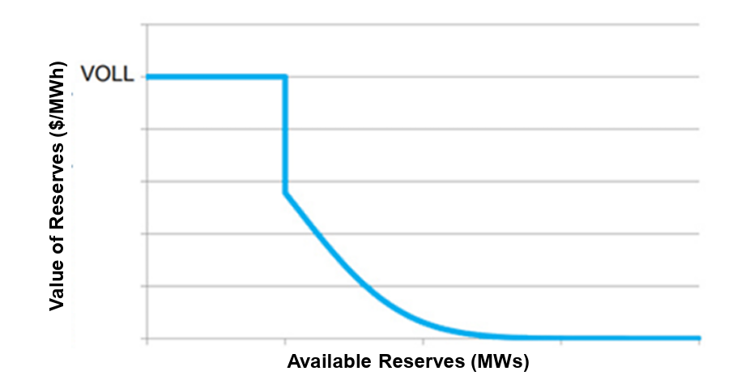
Operating reserve demand curves (ORDCs) are a widely implemented approach to CSP.
ORDC scarcity prices rise when there are shortages or near-shortages of target levels of operating reserves
  Conceptually grounded by linking price increases to system reliability risks, as measured by reserve deficiency
  In some markets, scarcity prices rise before violation of mandatory reserve requirements, to recognize the reliability value of additional reserves above the amounts required to avoid load shedding
From “Briefing on spotlight initiative – price formation enhancements,” James Friedrich, WEM Governing Body Meeting, October 28, 2025, p. 8; chart adapted from ERCOT. VOLL = Value of Lost Load, i.e., estimated cost to load of loss of electricity service
As a simplified alternative to ORDC, a latent supply margin concept (also called “supply margin demand curve”) has been proposed to create a price adder to energy prices that increases as available supply tightens, as measured by offers and BAA AS schedules

Slide 9
To support on-going work in the stakeholder initiative, the Governing Body requested my thoughts about stakeholder concerns and proposals about CSP.
Stakeholders provided extensive feedback on the CAISO’s August 2025 Straw Proposal and November 2025 presentation
The following slides comment on:
  Whether CSP would improve reliability
  Conceptual challenges of CSP design approaches
  Financial impacts of CSP on ratepayers

Slide 10
Thoughts about whether CSP would improve WEM reliability:
CSP is relevant to reliability even with regulatory must-offer requirements for capacity resources
  Applies when resources available for dispatch are unable to meet load and reserve requirements despite the must-offer requirement
  Under these scarce conditions, elicits incremental increases in supply or decreases in demand
CSP can gradually signal increasing scarcity as it develops, unlike other scarcity pricing mechanisms
  Motivates responses that will help to avoid reliability events
  Prospectively encourages supply from incremental imports, BAA supply above RSE requirements, and flexible loads (when enabled by utilities and regulators)
Additional reliability demand response resources (RDRR) are not a substitute for CSP. When operators call on RDRRs, it generally decreases prices, sending a price signal opposite to that needed for reliability (absent changes to fix this problem)

Slide 11
Thoughts related to how conceptually difficult it would be to develop CSP:
The initiative will take substantial time and resources
Lack of BAA consolidation in the WEM will require an approach to CSP different than that in other ISO/RTOs
  Will need to maintain BAA authority over the scheduling and dispatching of mandatory 10-minute reserves (per NERC)
  Need investigation of designs that would not include co-optimization of energy and 10-minute reserves across BAAs, e.g., a 30-minute reserve product
The WEM could leverage knowledge from ORDC and 30-minute reserve implementations in other regions
  Measures of reserves have been defined as well as how scarcity prices rise with declining reserve quantities
  Existing designs address the impact of transmission constraints, so that scarcity prices vary by region, depending on the location of rampable capacity and transmission constraints; scarcity prices might, for example, only occur within a load pocket

Slide 12
Thoughts related to how conceptually difficult it would be to develop CSP (continued):
It is unclear whether CSP could be more simply developed and implemented with a latent supply margin approach than with an ORDC
  Either methodology would need to develop and justify:
    Standardized accounting for the quantity of capacity each BAA has available to manage scarcity
    A metric to measure scarcity
    The dollar value of the scarcity price and how it rises with increasing scarcity
  Further design exploration is needed to understand:
    The role (or not) of co-optimization of energy and reserves under either of the approaches
    How the approaches would address transmission constraints and localized scarcity
    Why a latent supply approach could be simpler
  There is a question of how a latent supply margin approach would account for capacity that is available but has not been offered to the WEM by BAAs
    A BAA might hold this capacity as extra reserves or intend to sell it bilaterally
    Is a payment for reserves the best way to encourage BAAs to make this capacity visible to the market at an efficient price?

Slide 13
Thoughts about financial impacts of CSP on ratepayers:
CSP would affect prices only when extreme conditions occur, and at these times ratepayer costs would be offset by some benefits
  The implicit value of increased reliability
  Possible cost reduction from a decrease in the number of unit starts and in schedules for fixed hourly interchange that is not economic in real-time. Under result, these improvements could result from:
    Fewer out of market actions
    Increased supply from imports
    The potential unlocking of flexible demand through the provision of an efficient price signal that utilities and state regulators could use to encourage demand reductions by large customers
    The potential for a new reserve product to encourage BAAs to make more resources visible and available to the market under scarcity conditions, because they could be paid for providing reserve capacity rather than holding it back for own load or bilateral sales
Changes would likely occur to mitigate financial impacts on LSEs
  Adjustments to RA contracts to avoid over-payment for capacity
  Changes to enable LSE retail load to be dispatched off at high prices
Ratepayer impacts would be narrowed by a design in which scarcity prices differ by region

Slide 14
Thoughts about next steps to investigate CSP:
It will take time to develop CSP for an electricity market consisting of multiple BAAs rather than a single BAA
Two focused, conceptual projects would move the discussion forward:
  Evaluation of whether the latent supply approach could be simple to implement and whether it might have unintended consequences
  Assessment of whether scarcity pricing could be implemented with co-optimization of a 30-minute reserve product and, perhaps, 10-minute reserves above BAA required target levels (i.e., reserves above NERC mandates)
These evaluations would advance suggestions of the MSC and DMM
  The MSC has advocated over time for the development of a 30-minute or hourly reserve product for the WEM
  The DMM strongly encourages development of an hourly reserve product to maintain upward imbalance reserves and reduce the use of a large real-time load bias (i.e., conformance)

Slide 15
APPENDIX
Comprehensive Scarcity Pricing in U.S. ISOs
Notes:
Remove citation?

Slide 16
ISO scarcity pricing designs indicate the relevance of CSP.
Scarcity Pricing Approach | ISOs (excluding WEM) | Implementation Notes
Day-Ahead Market ORDC(s) | All, except CAISO | Shape and height of ORDCs differ; 10- and 30-minute products in ERCOT, MISO, NYISO, PJM and ISO-NE
Real-Time Market ORDC(s) | All, but not co-optimized in CAISO (SRDC)
Allow high ORDC scarcity price with extreme shortages | All ORDC maximum prices exceed $2,000/MWh | ERCOT $5,000/MWh MISO $6,000/MWh
Scarcity price increases prospectively to signal reliability risk | MISO, NYISO, ISO-NE, and PJM tariff targets are greater than mandatory NERC requirements | Increasingly accepted
Employ scarcity prices when operators manually intervene to maintain system reliability | All ISOs set prices at cap when load curtailed Pricing varies for other actions, such as export curtailment | Manual actions can disrupt effectiveness of ORDC pricing

